Slide 1

FUEL THEFT DETECTION AND FUEL CONSUMPTION MONITORING SYSTEM

Slide 2
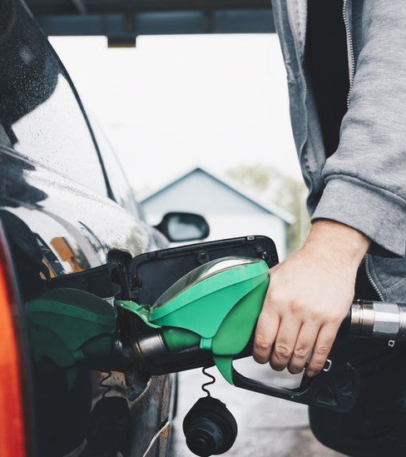

PRESENTATED BY:
Rifat Bin Hossain (011201434)
Abed Jafry (011201350)
Badruddoza Dhrubo (011201010)
Nusrat Jahan Bably (011201435)

Slide 3

PROBLEM STATEMENT
Today's world faces a serious issue with fuel theft. Fuel is a valuable resource for civilization because it is a finite source of energy on the planet. In order to address these problems, a trustworthy monitoring system that can identify unauthorised fuel withdrawals and encourage fuel-efficient driving habits is needed. Our idea offers a revolutionary system that integrates a number of sensors and modules in order to accomplish these goals. ​

Slide 4
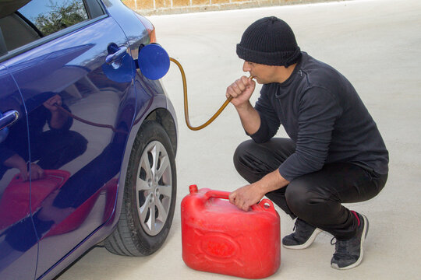
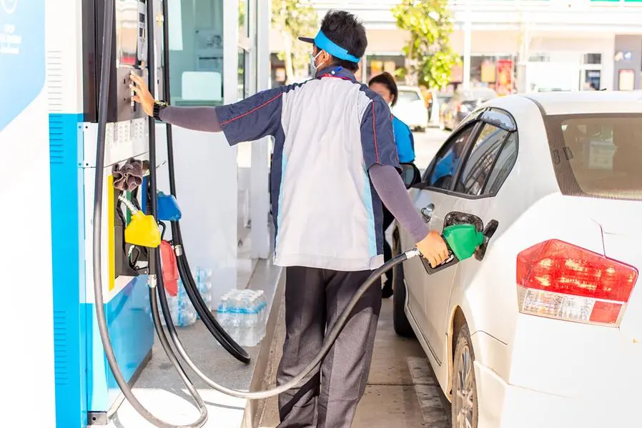

IN THIS PICTURE WE CAN SEE A MAN
STEALING OIL DIRECTLY FROM THE CAR
IN THIS PICTURE WE CAN SEE HOW OIL
IS RIGGED FROM THE GAS PUMP AND
GIVEN LESS AMOUNT TO THE USERS.
CAR OWNERS OFTEN WORRIED IF THE
CAR USING EXCESSIVE FUEL

Slide 5
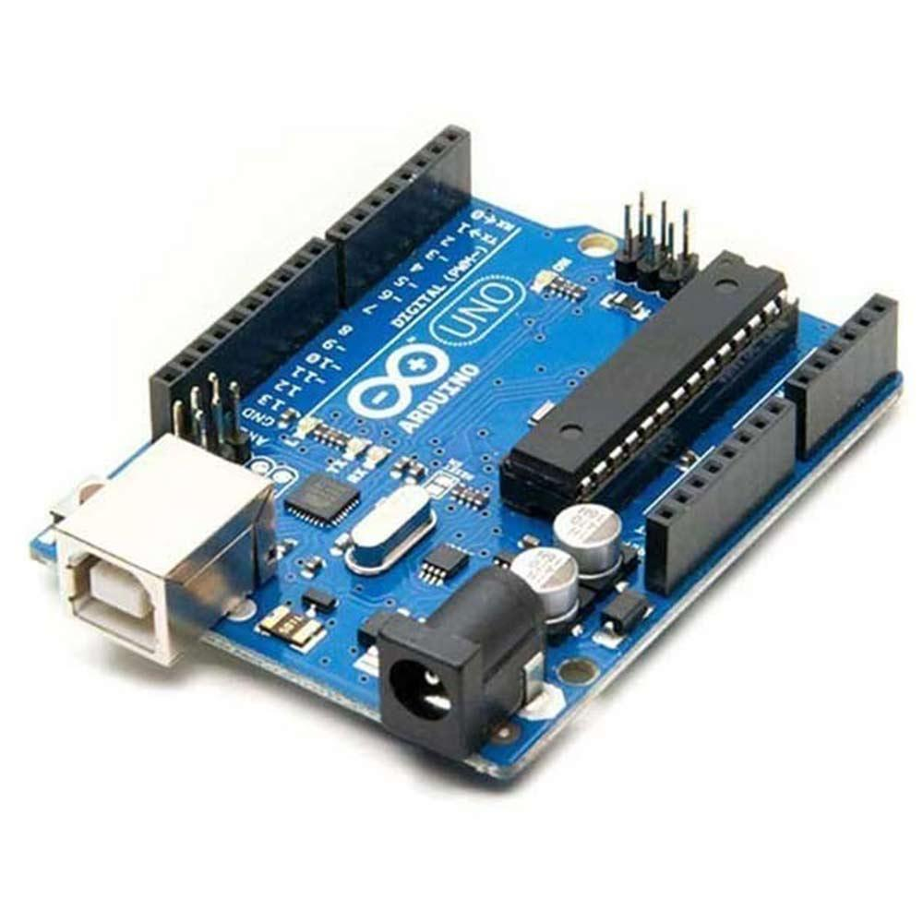
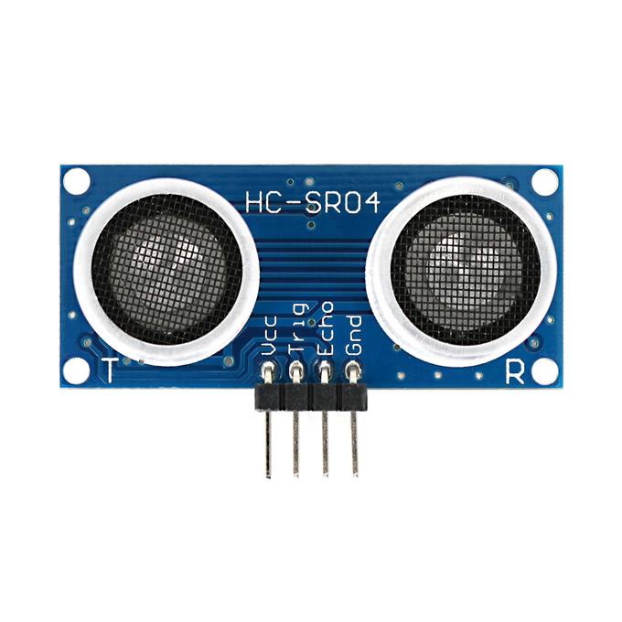
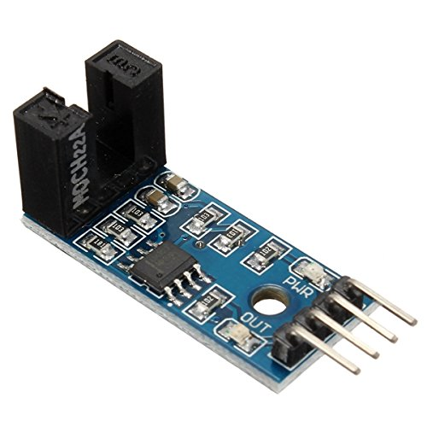
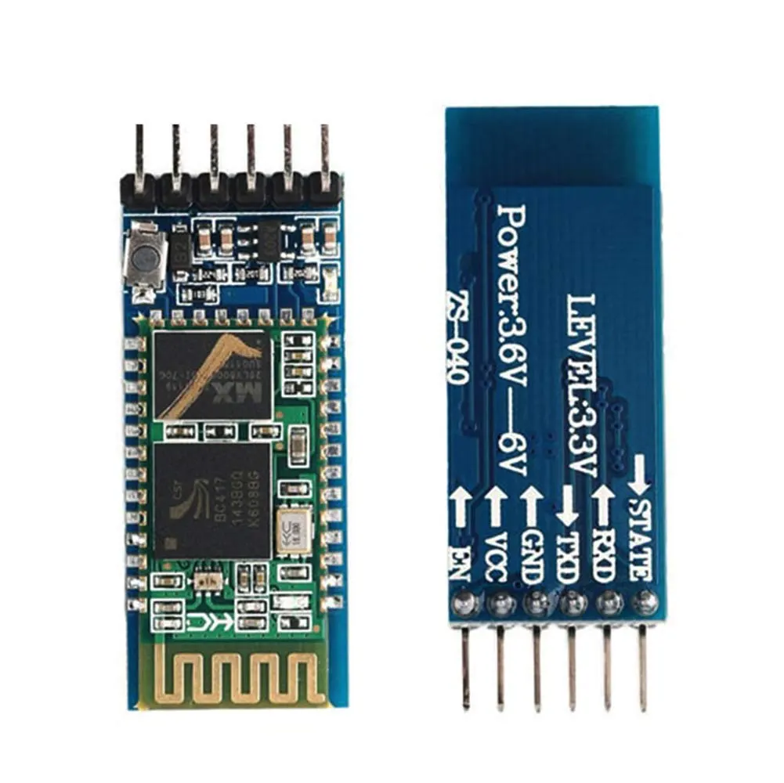
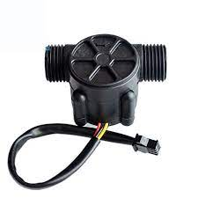
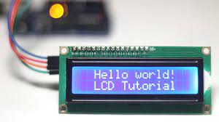
COMPONENTS:
SONAR SENSOR (ULTRASONIC SENSOR) TO MEASURE THE OIL LEVEL IN THE TANK
ARDUINO UNO BOARD
SPEED SENSOR TO DETECT VEHICLE MOVEMENT
BLUETOOTH MODULE FOR SENDING SMS ALERTS
LCD DISPLAY FOR SHOWING RELEVANT INFORMATION
FLOW METER TO MEASURE OIL FLOW

Slide 6
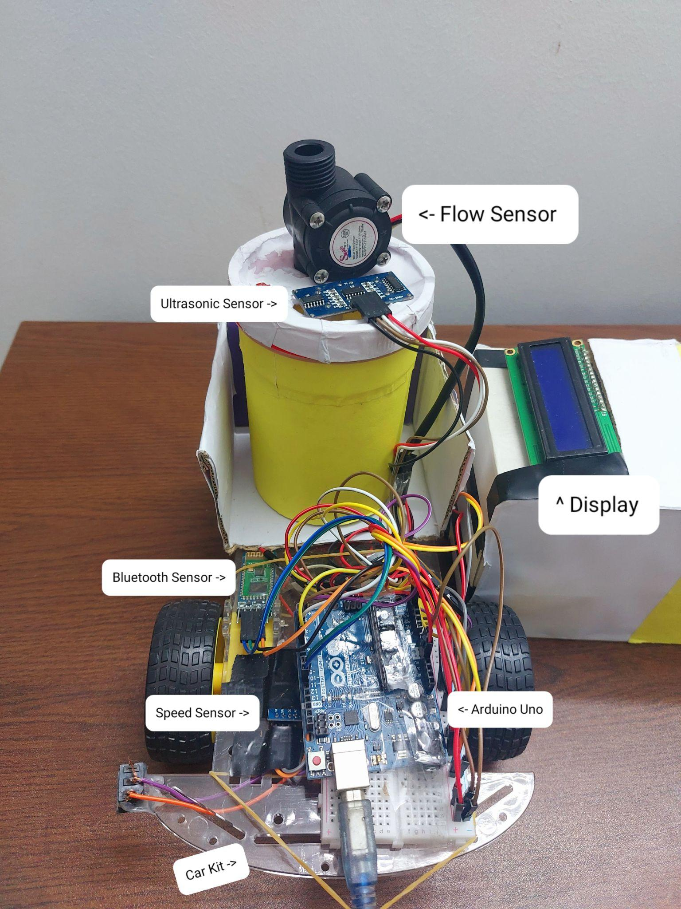
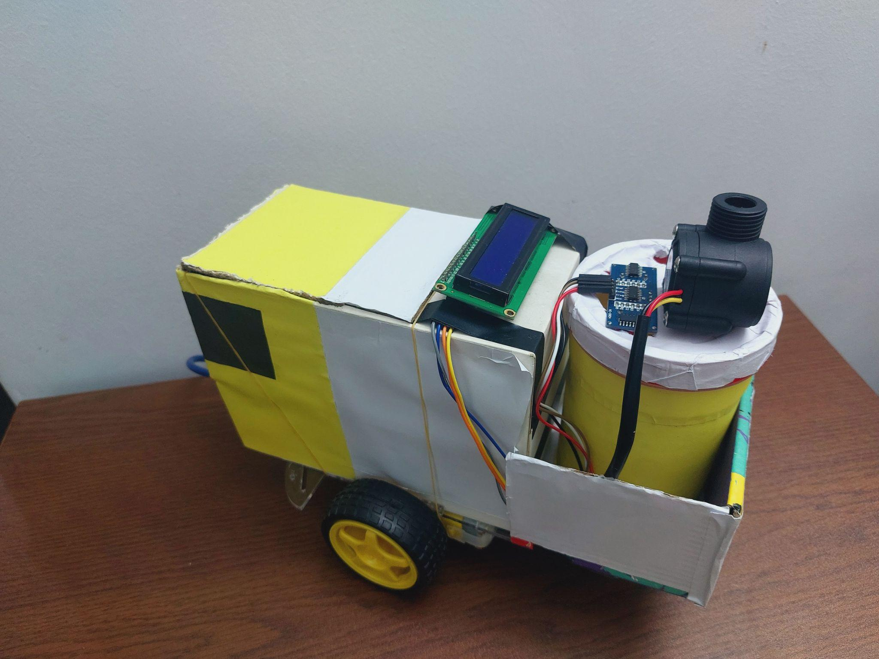

Slide 7
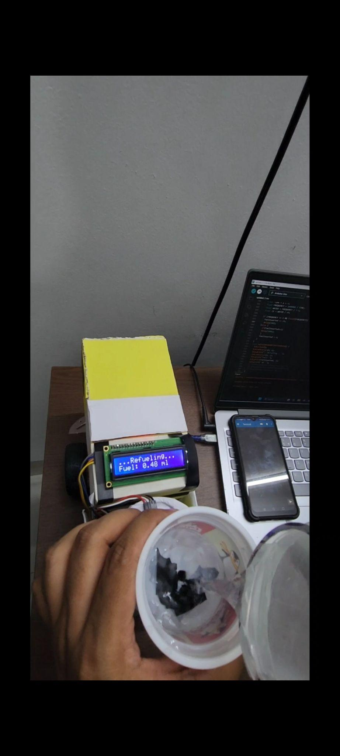
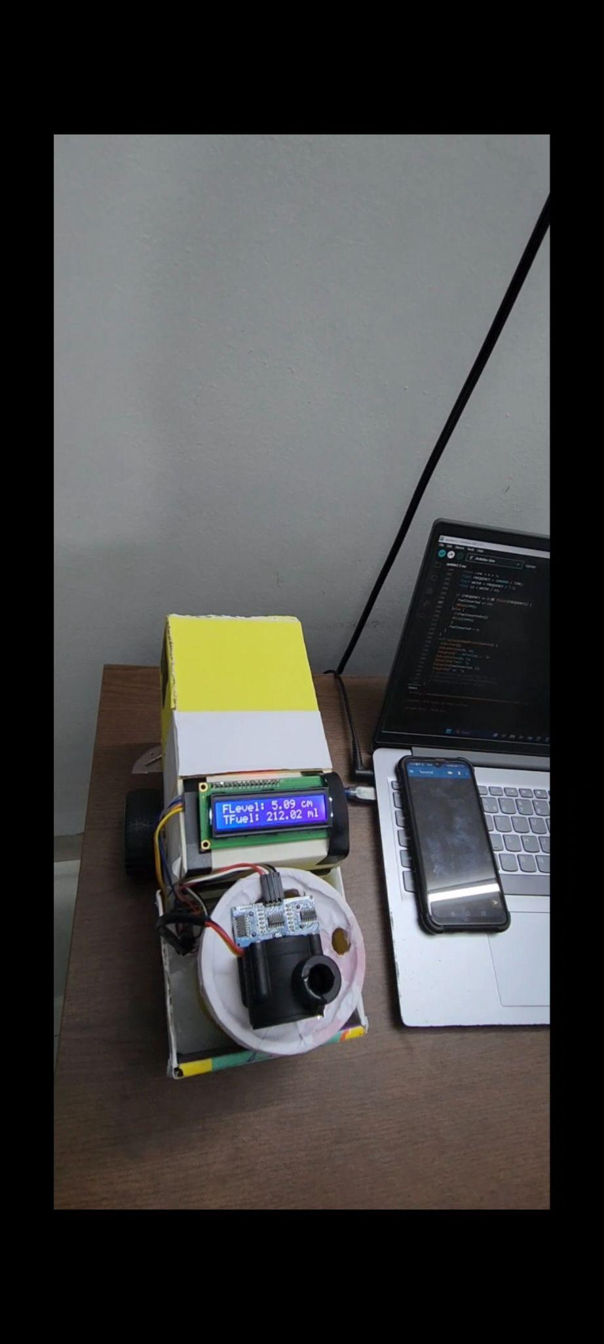
Flow meter measuring how much fuel going through
Fuel Level and Total Fuel showing to the display

Slide 8
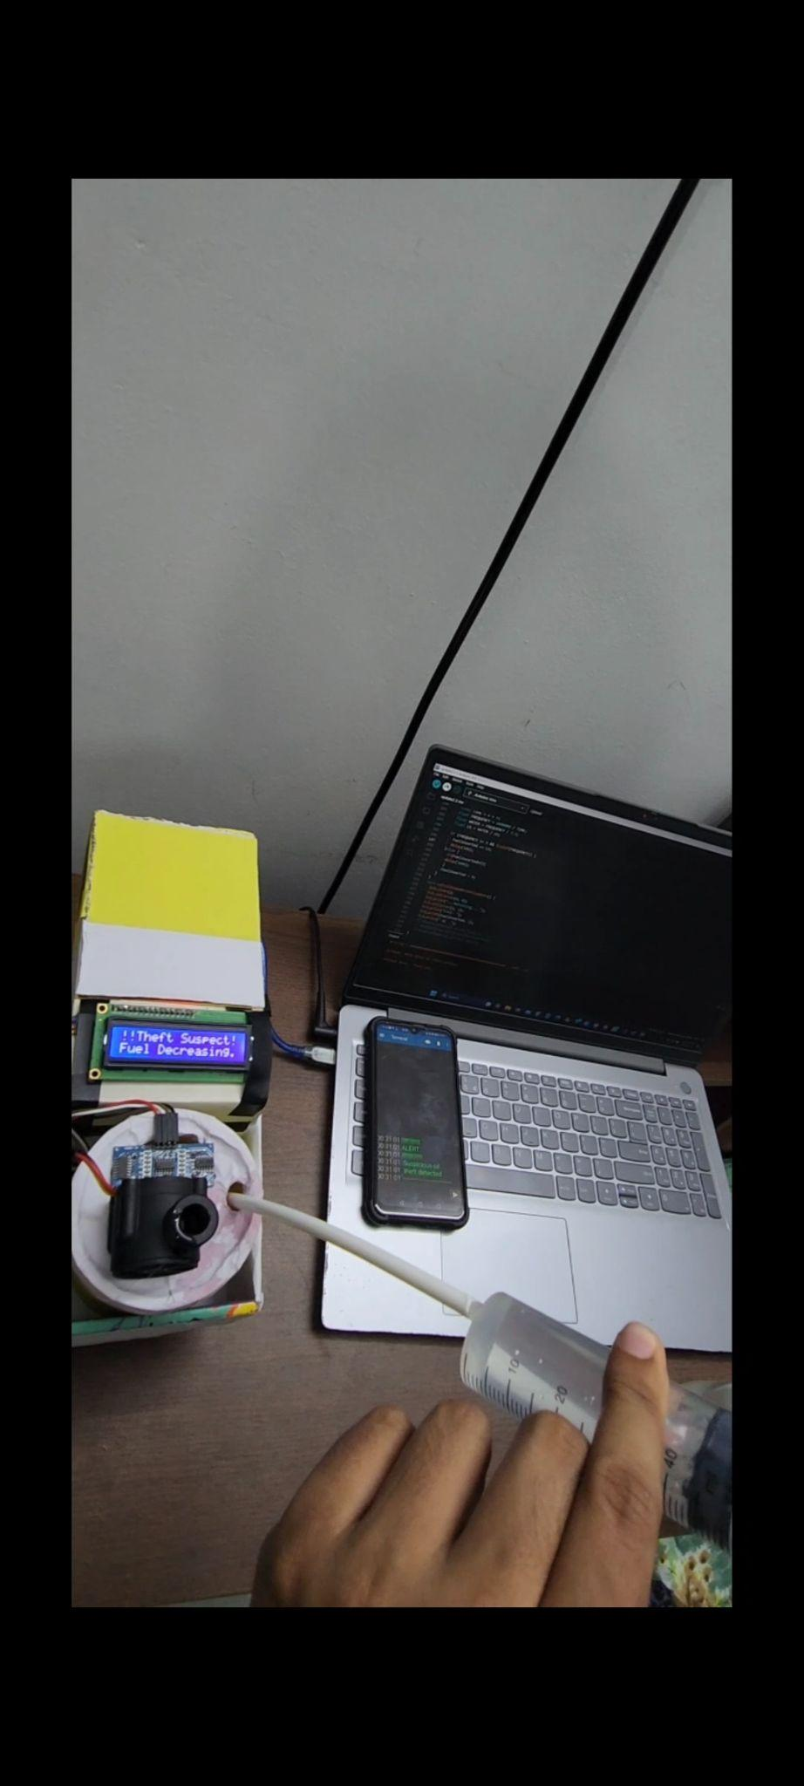
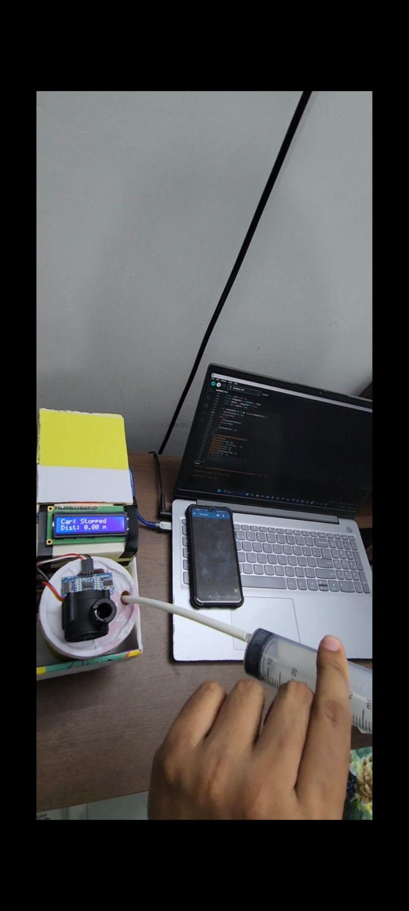
Extracting fuel while car is not moving
Theft detected and send an alert message to the owner

Slide 9
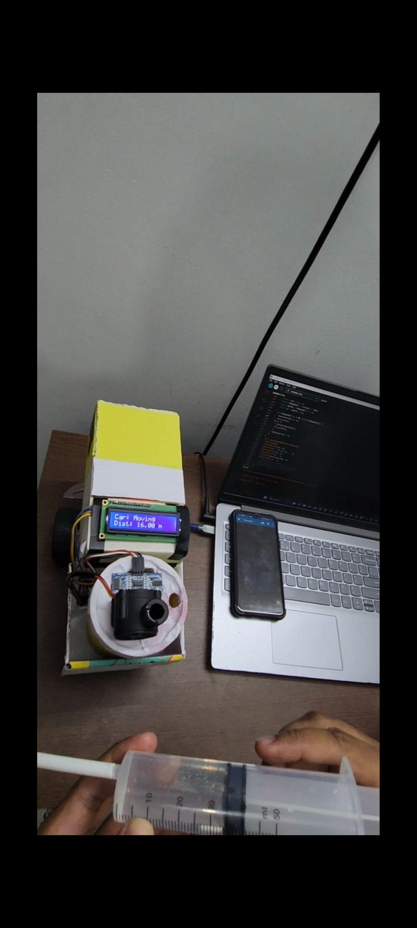
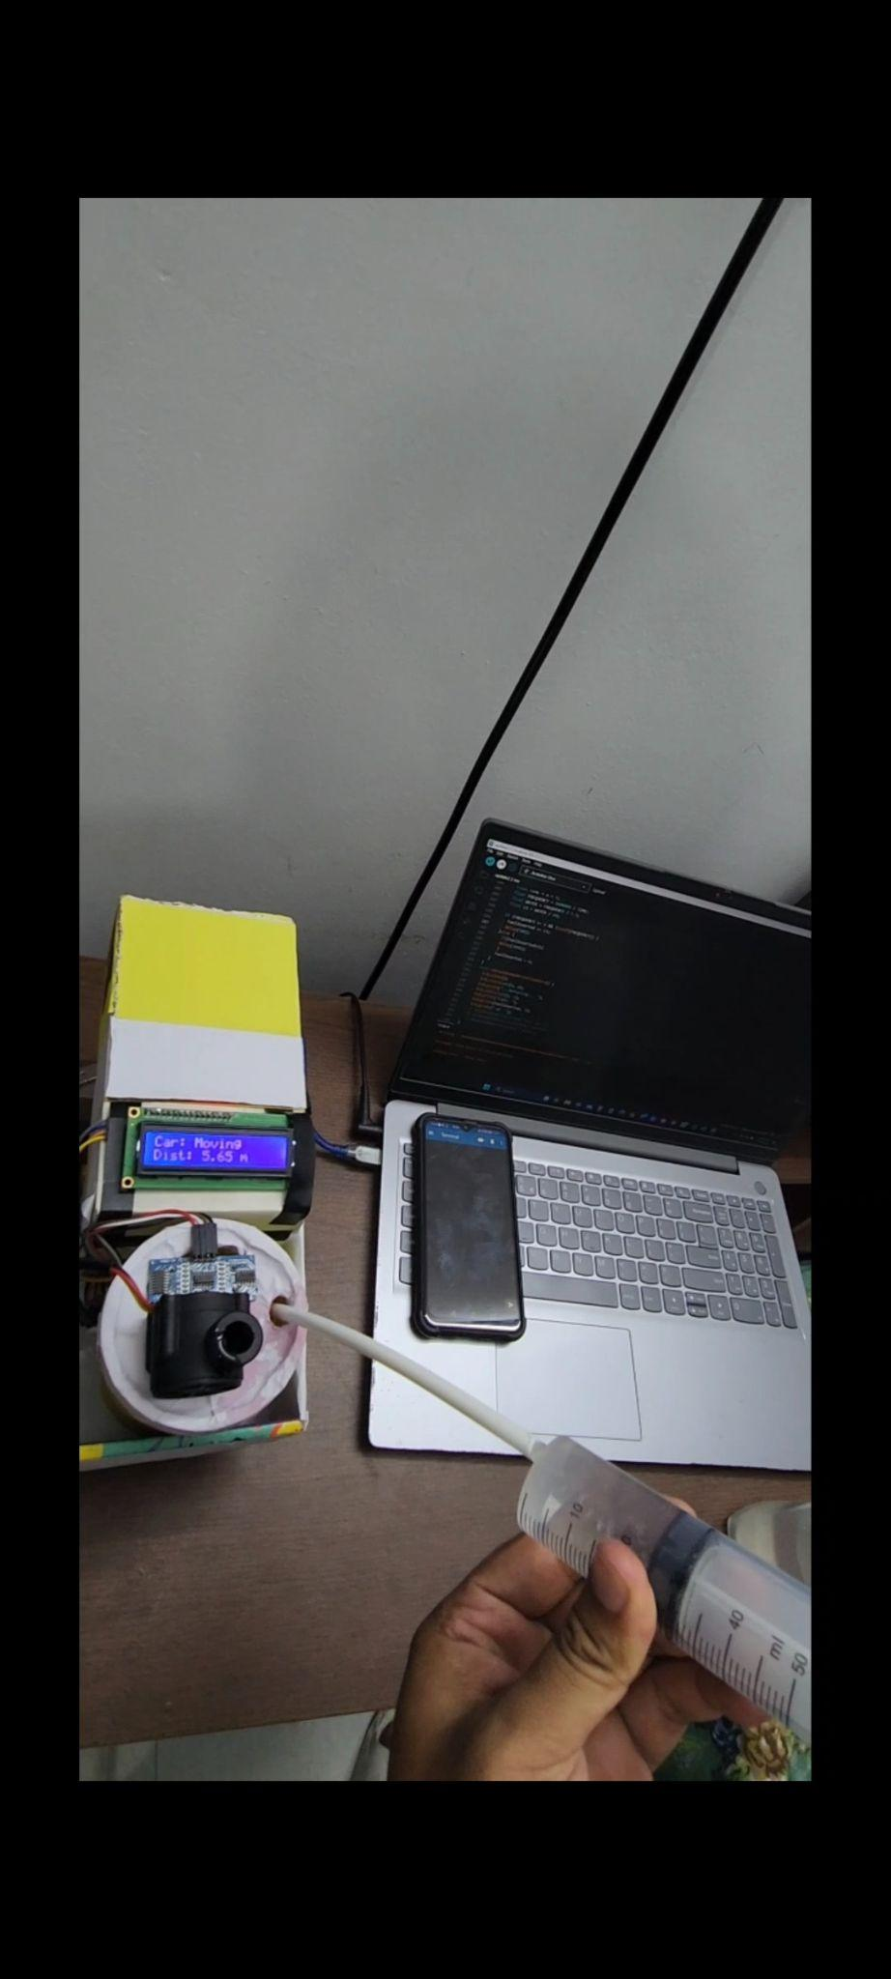
Fuel consuming during the car moving
No alert given, as fuel consumed as expected

Slide 10
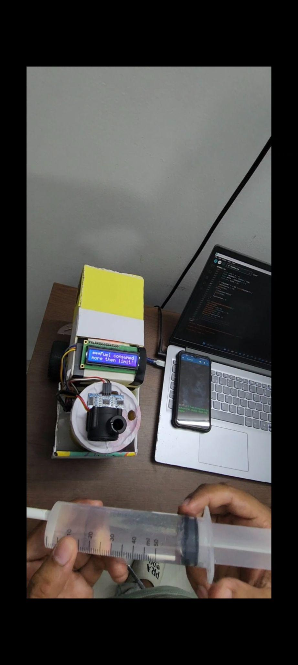
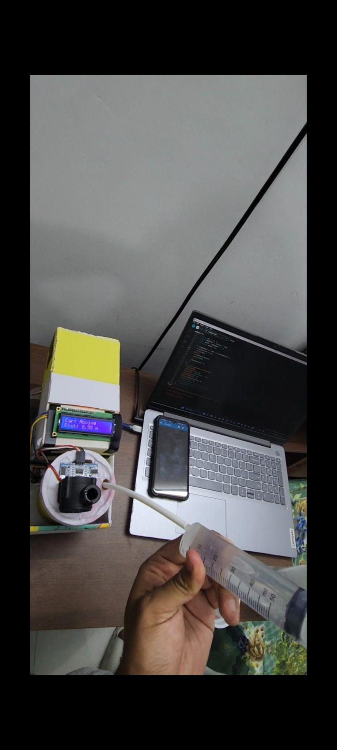
Excessive fuel consumed during car running
Alert given, as fuel consumed more then the limit

Slide 11
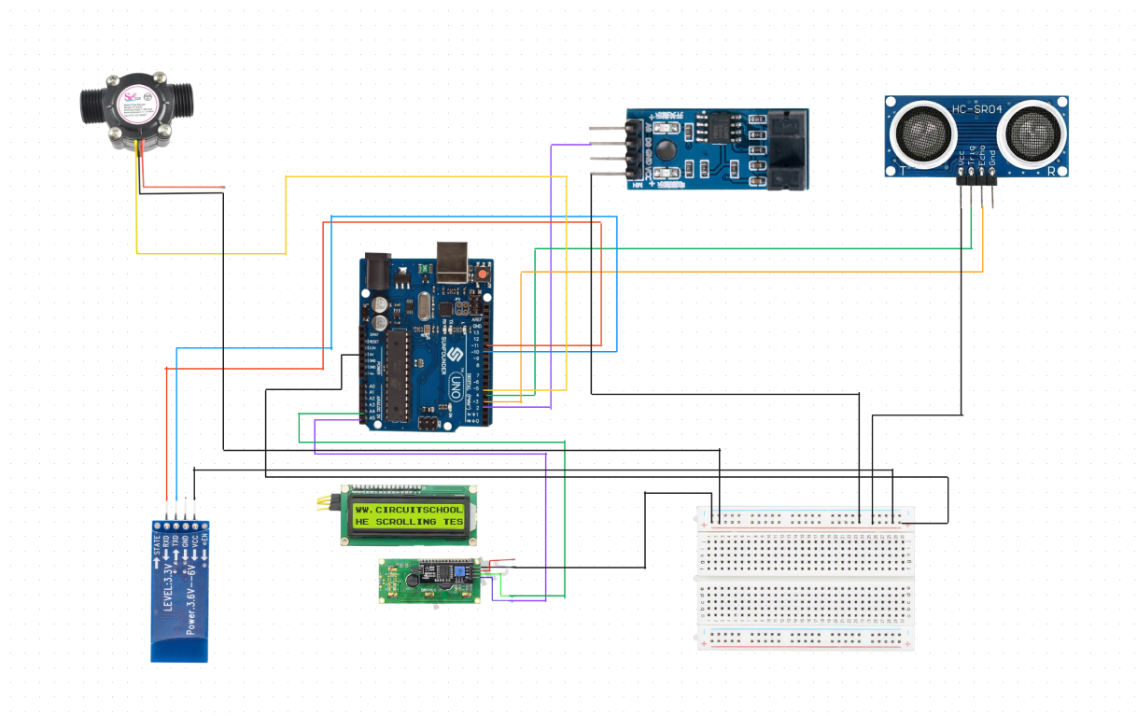
CIRCUIT DIAGRAM

Slide 12
Report and Full project video link: https://drive.google.com/drive/folders/1SzU553s9zFCFgP6CDkXJvOCWlp4kRo-l?usp=sharing
Github Link: https://github.com/Rifat-BH/Fuel-Theft-detection-and-Excessive-fuel-Consumption-monitoring-system.git

Slide 13

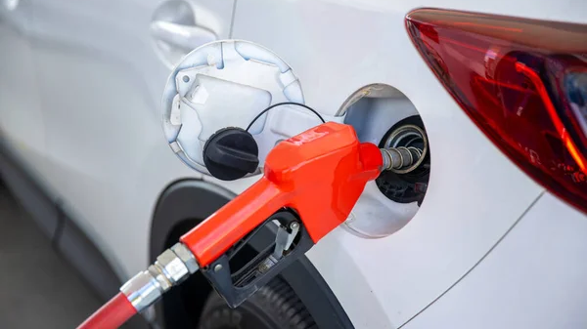
CONCLUSION
Future Work: 1. User can set a range of fuel consumption limit 2. Make the Ultrasonic sensor water resistance and build a shutter for the sensor while car on running stage. 3. Use GSM instead of Bluetooth module
4. Use GPS to track location and and identify traffic area.
In essence, the Fuel Theft Detection and Fuel Consumption Monitoring System stands as a pivotal innovation to counteract losses due to theft and enhance fuel usage efficiency. ​

Slide 14
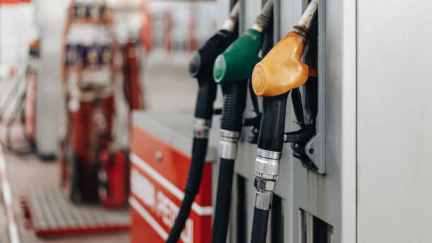
THANK YOU EVERYONE

